Slide 1
NN + oscillations revival
16/05/2023

Slide 2
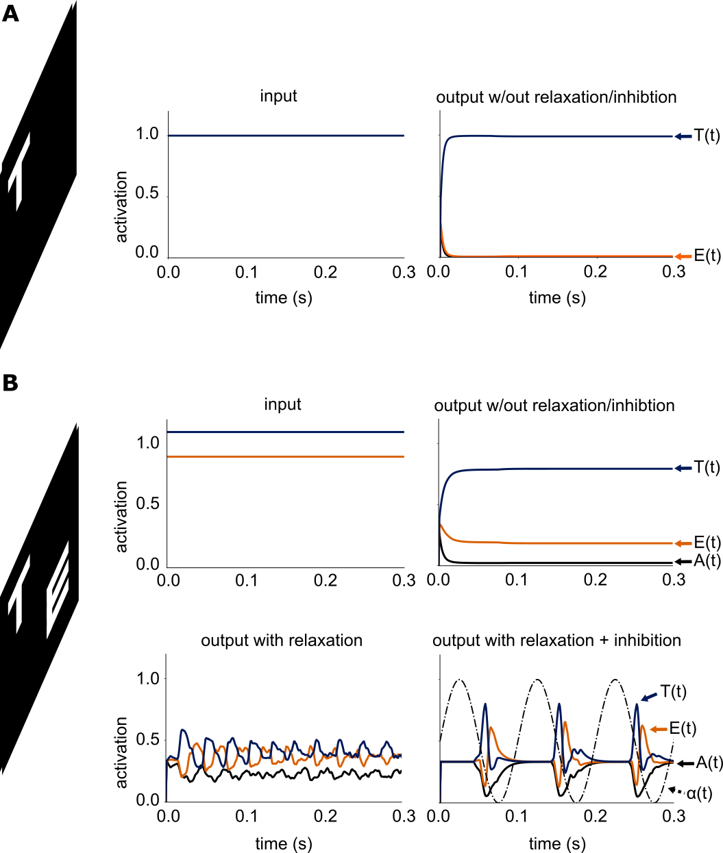
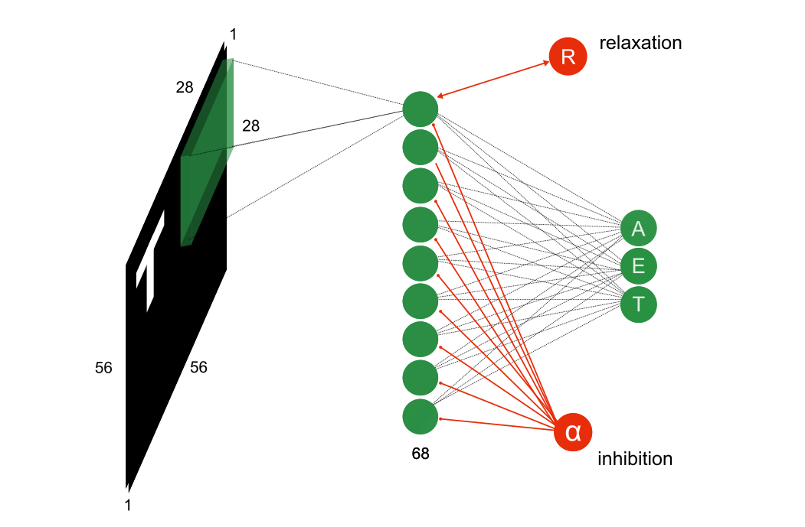
Where we are at - CCN abstract
One-layer network
Convolutional kernel for weight-sharing between quadrants
Set bias and slope
Train by minimizing MSE

Slide 3
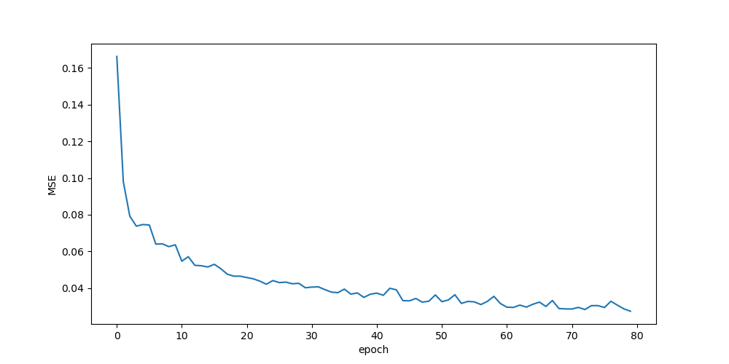
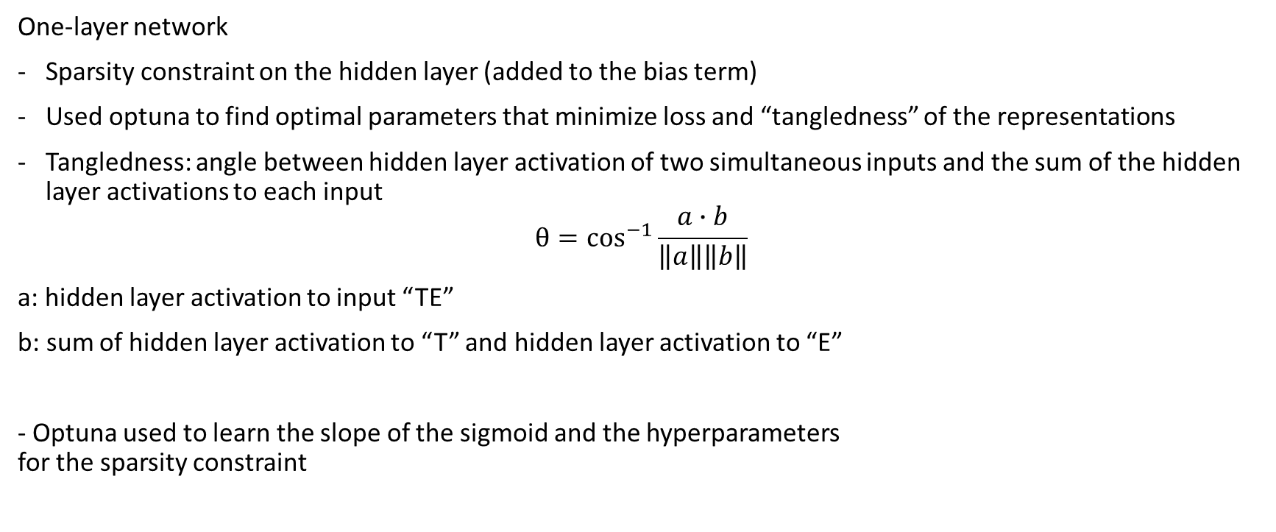
Where we are at – hyperparameter optimization with optuna
One-layer network
Sparsity constraint on the hidden layer (added to the bias term)
Used optuna to find optimal parameters that minimize loss and “tangledness” of the representations
Tangledness: angle between hidden layer activation of two simultaneous inputs and the sum of the hidden layer activations to each input
$$θ=\cos^{−1}{\frac{a∙b}{\left\|a\right\|\left\|b\right\|}}$$
a: hidden layer activation to input “TE”
b: sum of hidden layer activation to “T” and hidden layer activation to “E”
- Optuna used to learn the slope of the sigmoid and the hyperparameters for the sparsity constraint

Slide 4
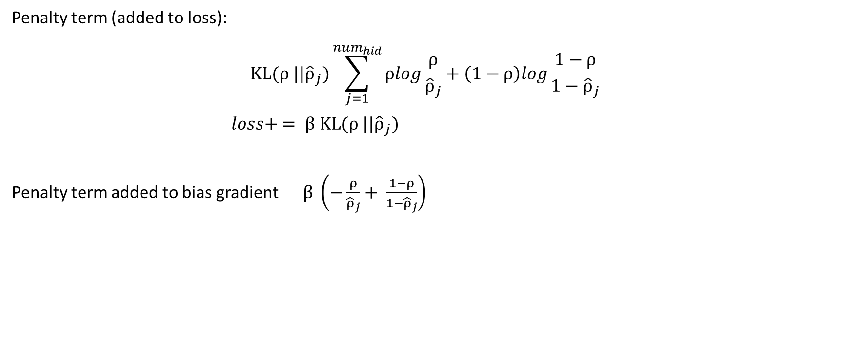
Learned bias sparsity constraint
Penalty term (added to loss): $$KL(ρ ||{\hat{ρ}}_{j})\sum_{j=1}^{num_{hid}}{ρlog\frac{ρ}{{\hat{ρ}}_{j}}+\left(1−ρ\right)log\frac{1−ρ}{1−{\hat{ρ}}_{j}}}$$
$loss+ = β$ $KL(ρ ||{\hat{ρ}}_{j})$
Penalty term added to bias gradient $β \left(−\frac{ρ}{{\hat{ρ}}_{j}}+ \frac{1−ρ}{1−{\hat{ρ}}_{j}}\right)$

Slide 5
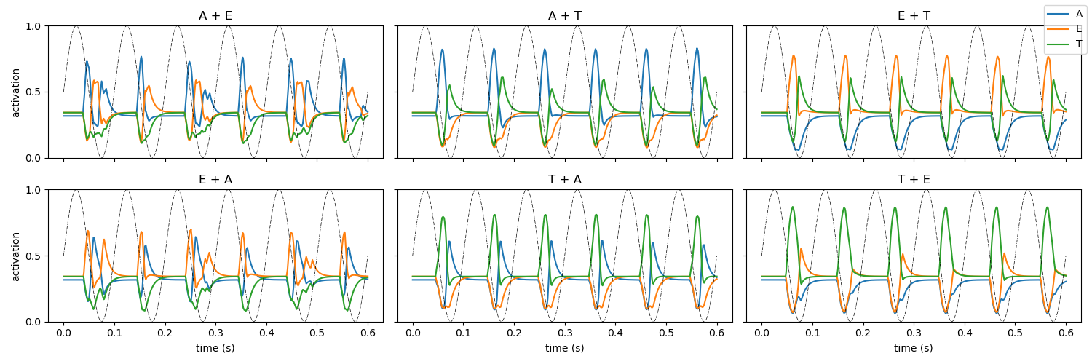
Where we are at – hyperparameter optimization with optuna

Slide 6
Where we are at – hyperparameter optimization with optuna

Slide 7
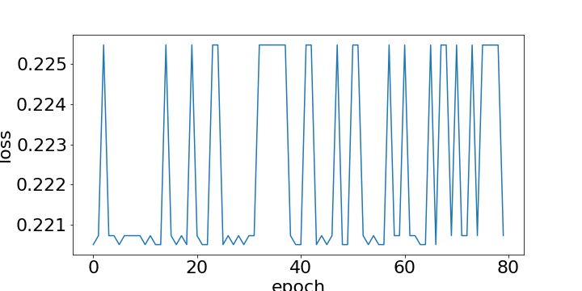
2 Layer AET – does not learn
Not with learned or set bias
Same number of parameters as one layer network .. (?)

Slide 8
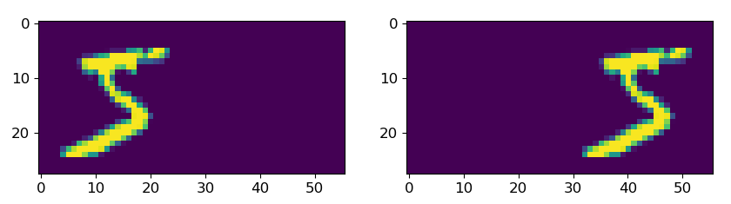
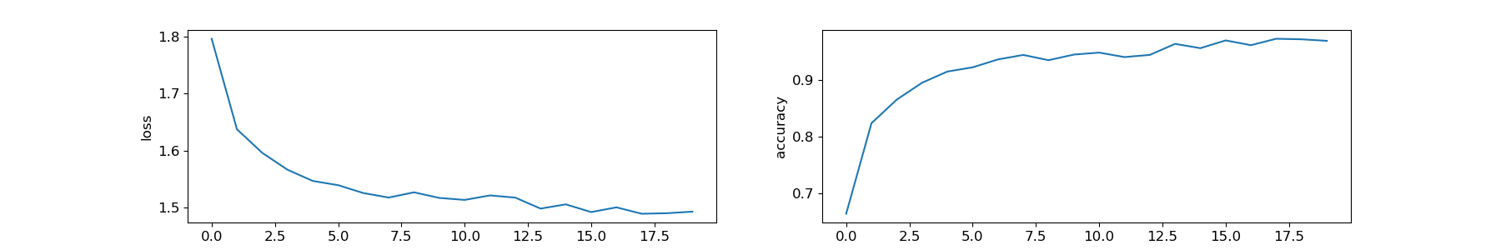
MNIST – 2 layer FC network
Two-layer network
Fully connected layers with 64 and 32 units
Trained on MNIST digits presented on the left and right
Learned bias (no sparsity constraint for now..)

Slide 9
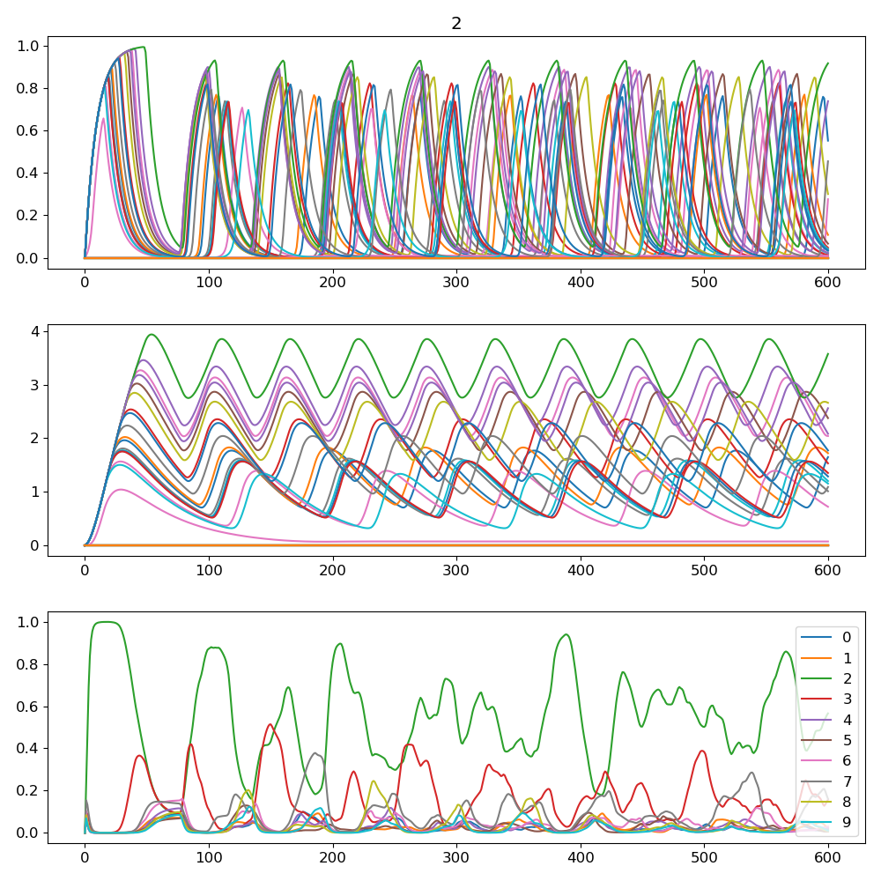
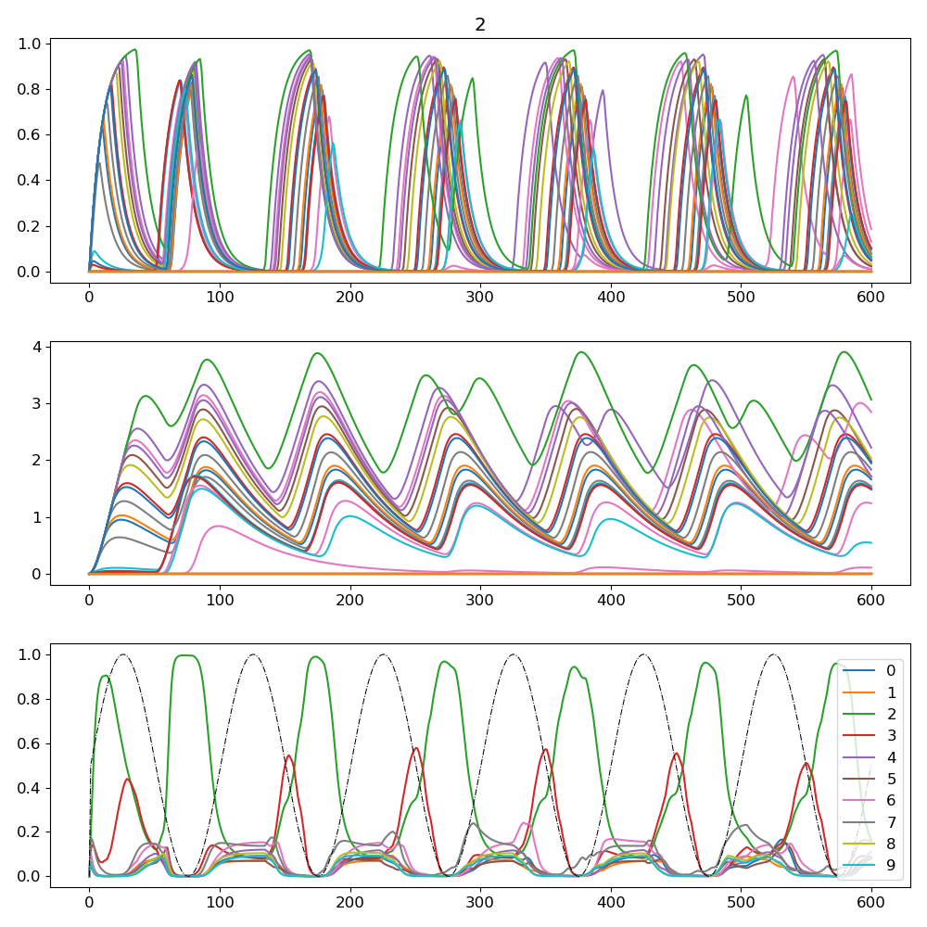
MNIST – 2 layer FC network
Dynamics added to first hidden layer, single input
No alpha
alpha

Slide 10
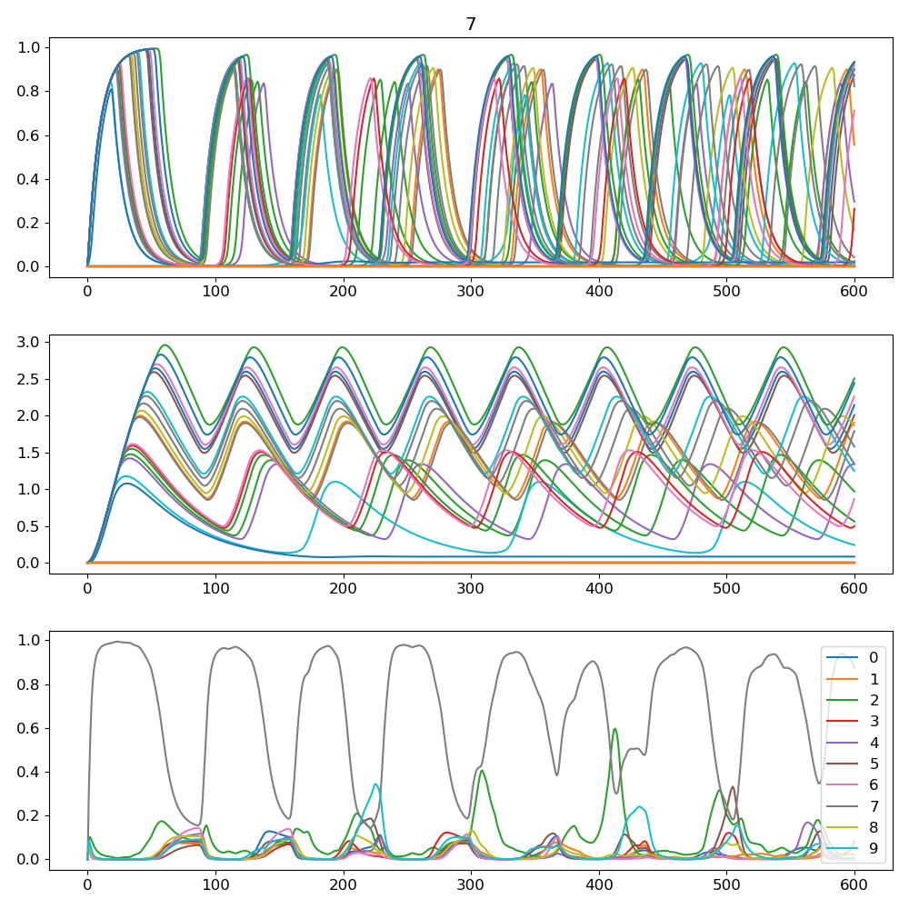
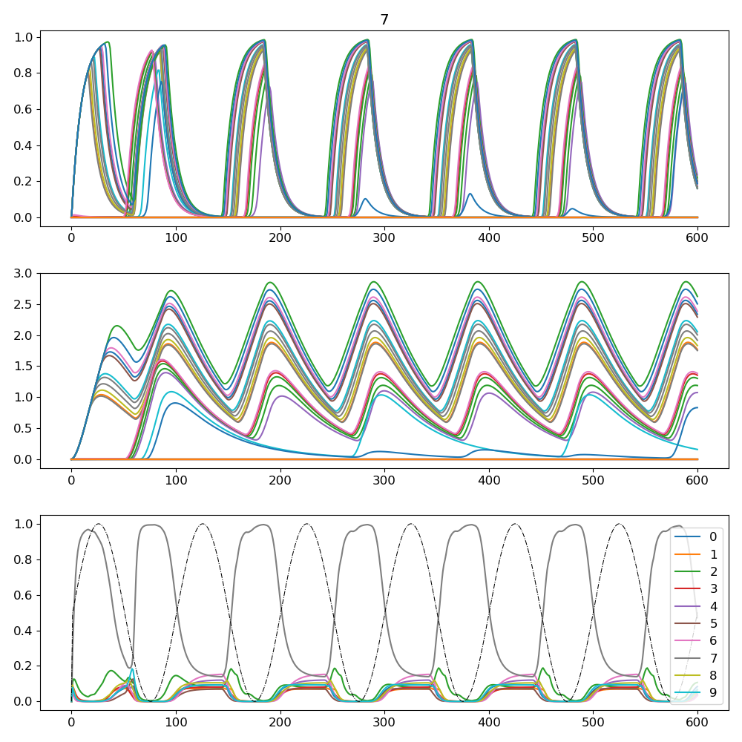
MNIST – 2 layer FC network
Dynamics added to first hidden layer, single input
No alpha
alpha

Slide 11
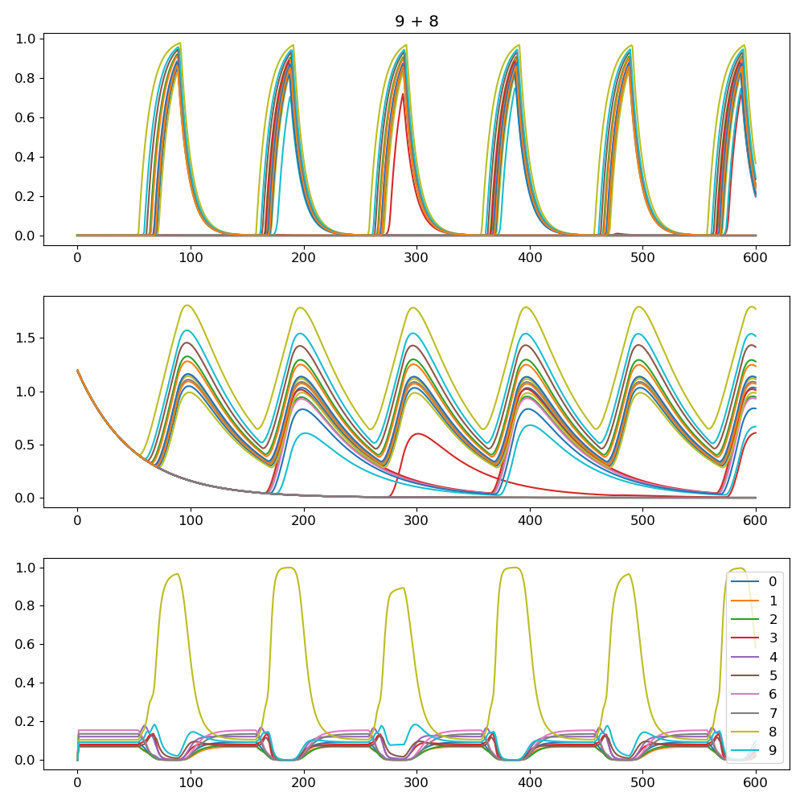
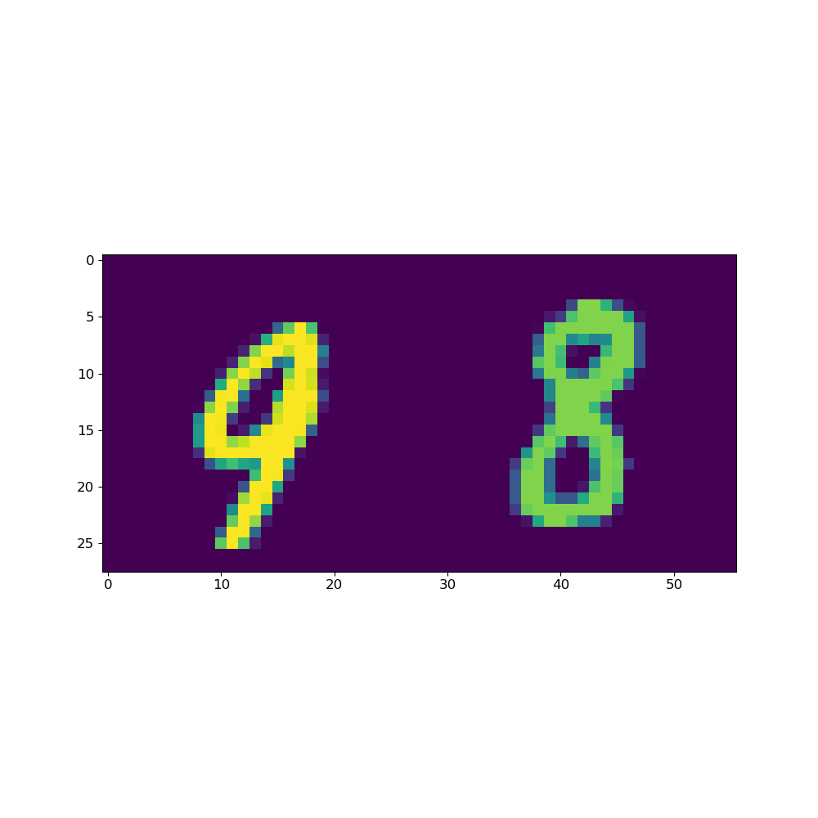
MNIST – network rarely separates two inputs successfully

Slide 12
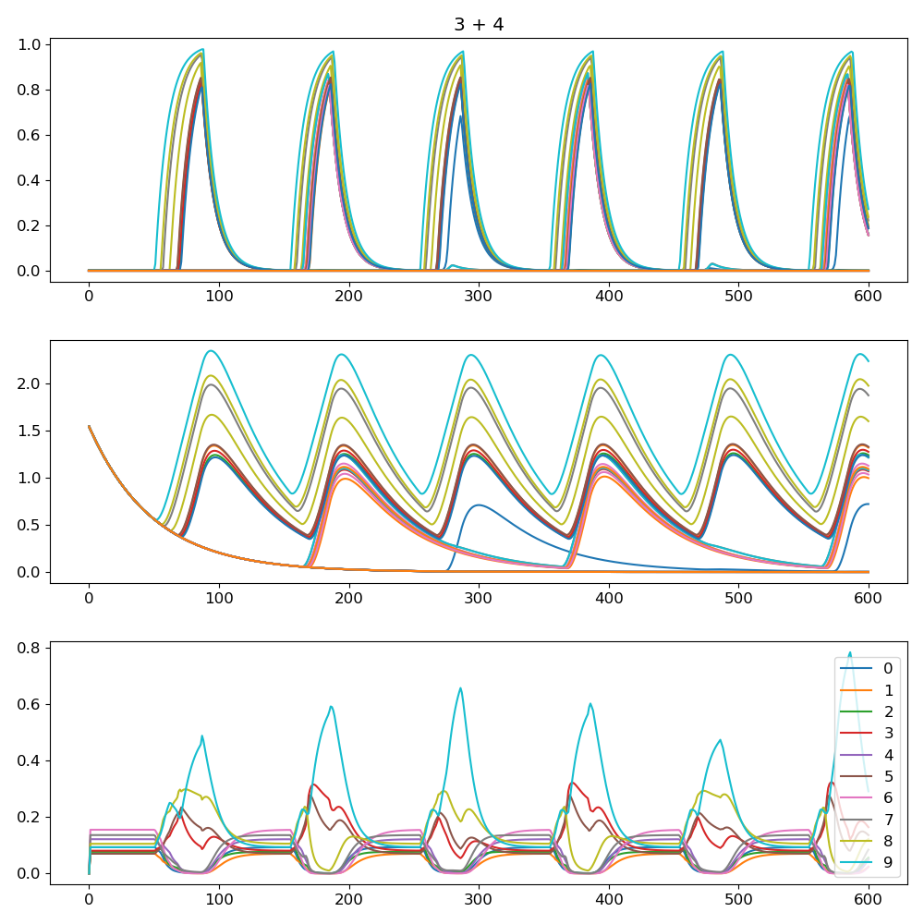
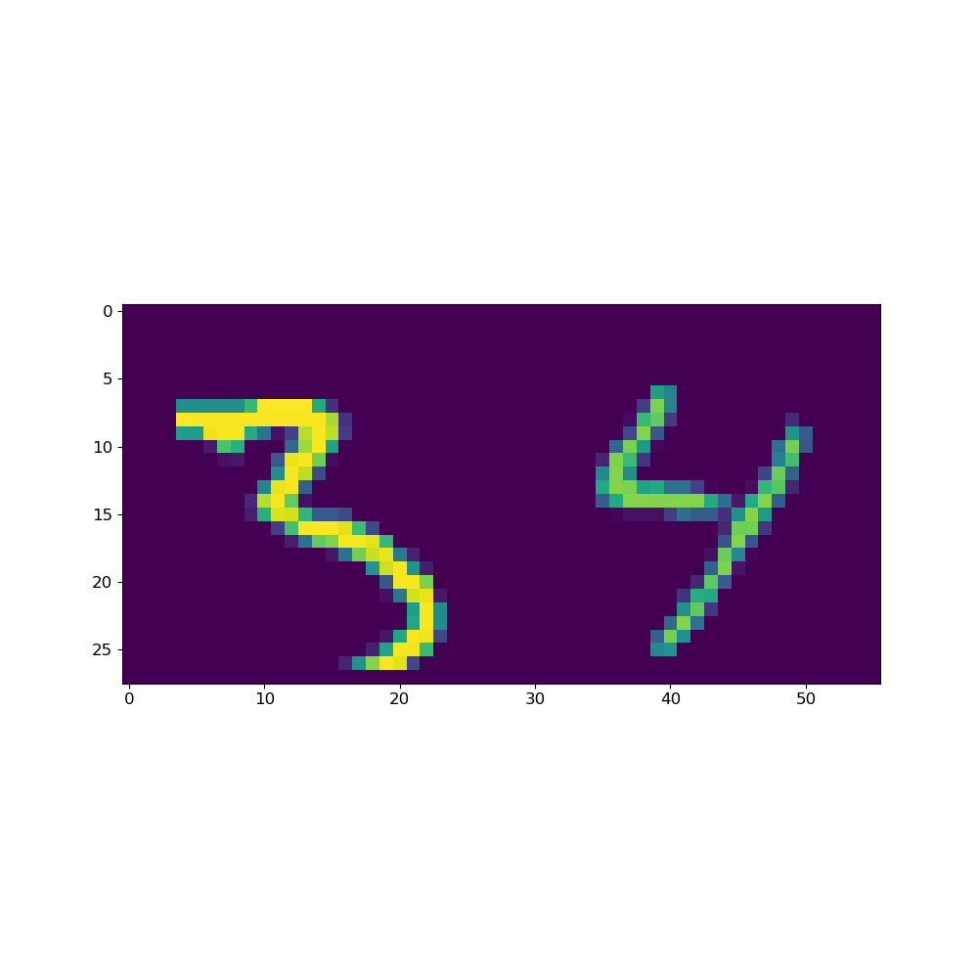
MNIST – network confuses two inputs for one input (due to weight-sharing ?)

Slide 13
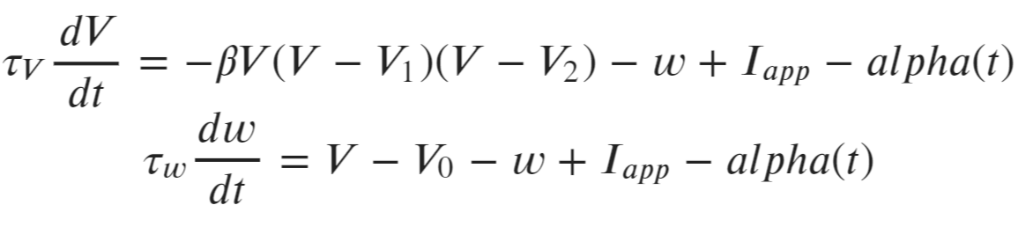
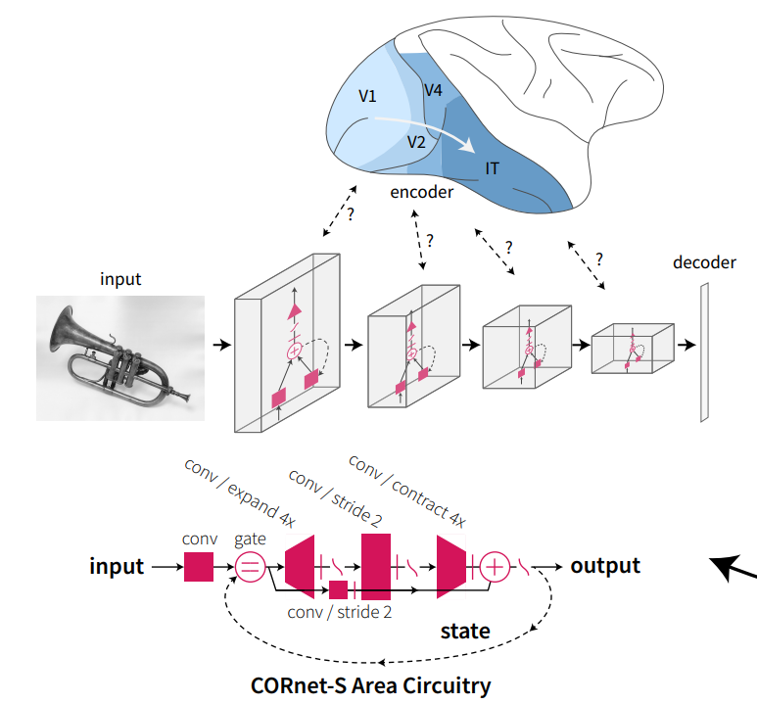
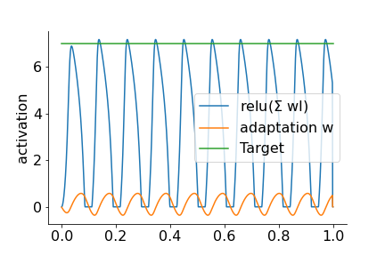
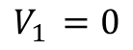
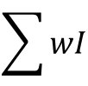
CSHL project – adding dynamics to CORnet-Z
$$\sum{wI}$$
$$V_{1 }=0$$
\

Slide 14
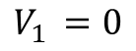
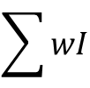
CSHL project – adding dynamics to CORnet-Z
$$\sum{wI}$$
$$V_{1 }=0$$
\

Slide 15
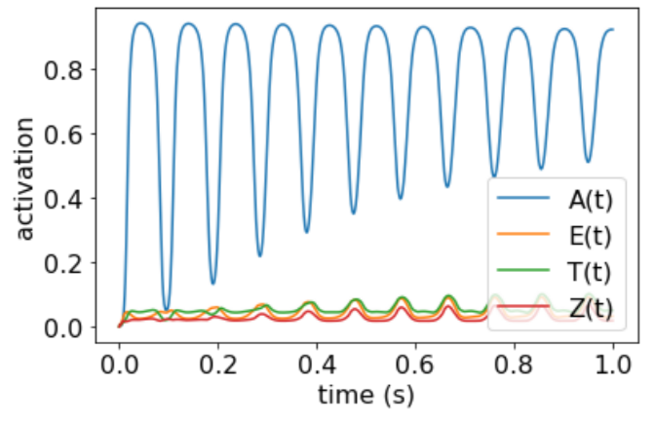
CSHL project – adding dynamics to CORnet-Z
Alpha amplitude = 0

Slide 16
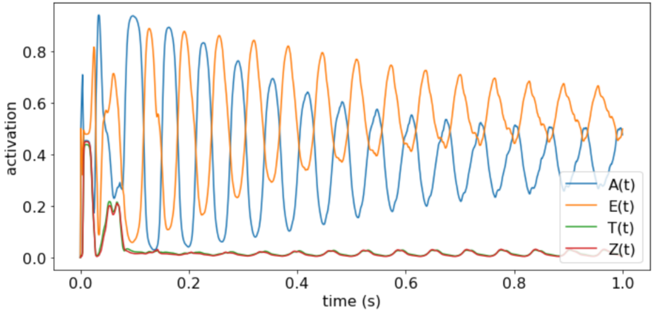
CSHL project – adding dynamics to CORnet-Z
Alpha amplitude = 0

Slide 17
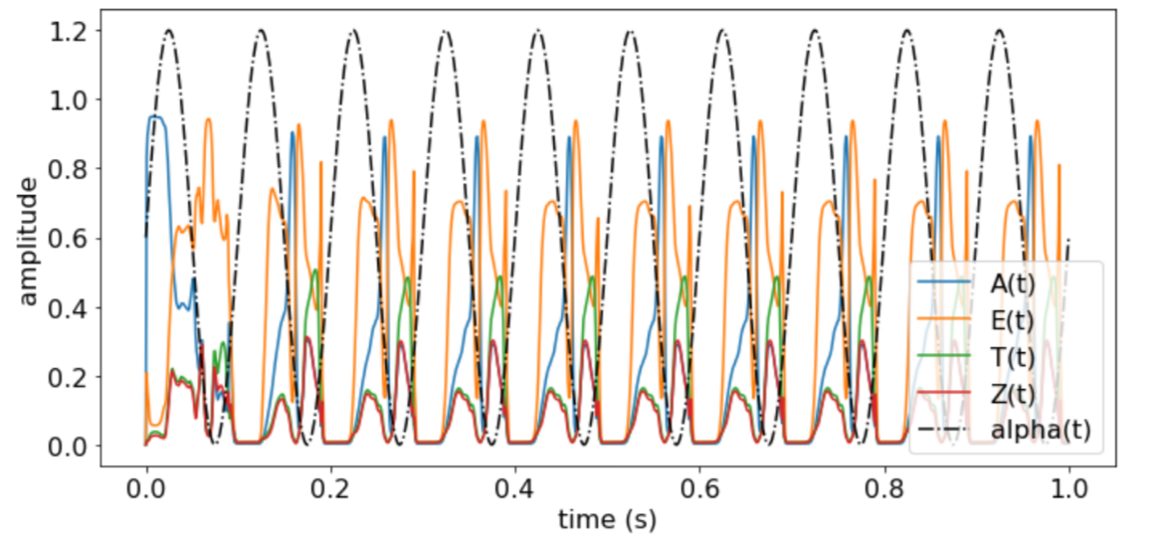
CSHL project – adding dynamics to CORnet-Z

Slide 18
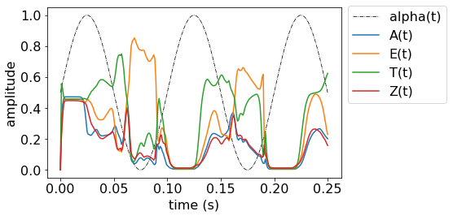
CSHL project – adding dynamics to CORnet-Z

